Slide 1



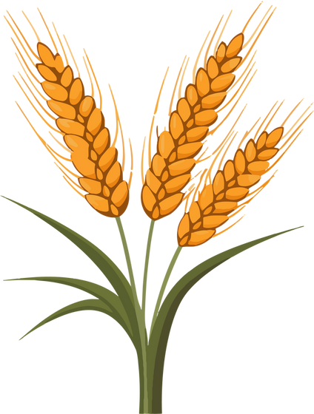





AGRITECH: REVOLUTIONIZING AGRICULTURE WITH ML & DL
PRESENTED BY
SAKSHI SHAW PRITAM PRADHAN KOUSTAV SANTRA SOUMYADEEP DUTTA

Slide 2
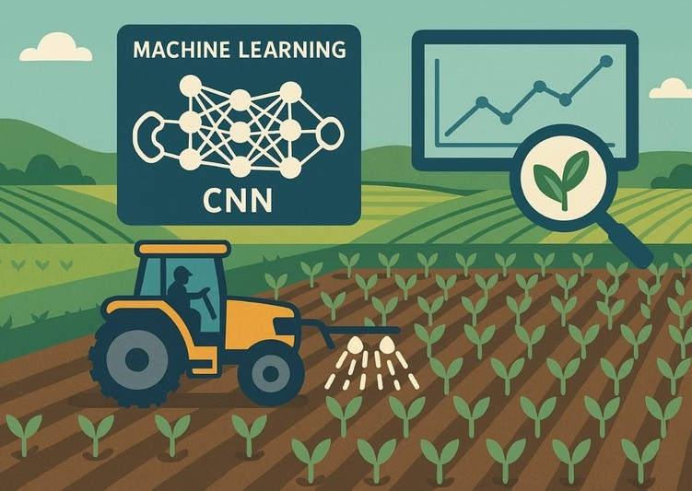

Introduction
This project leverages Machine Learning, and Deep Learning to support farmers with a smart, web-based platform offering three core features: Crop Recommendation based on soil and environmental conditions, Plant Disease Detection through leaf image analysis, and Water Requirement Prediction using key climate and soil
factors. The platform decision-making, boosts
empowers productivity, sustainable
informed reduces farming
costs, and promotes practices.

Slide 3
Project ModuLes Overview
1. Crop Recommendation (Random Forest Classifier)
Suggests the most suitable crop based on soil nutrients and weather conditions. Helps maximize yield and reduce resource waste.
2. Disease Detection (CNN on Leaf Images)
Detects plant diseases from leaf photos using deep learning. Enables early diagnosis and quick action to save crops.
3. Water Requirement Prediction (Random Forest Regressor) Estimates daily irrigation needs using weather and crop data. Promotes efficient water use and supports sustainable farming.

Slide 4

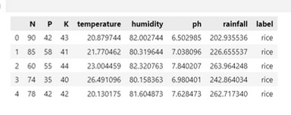

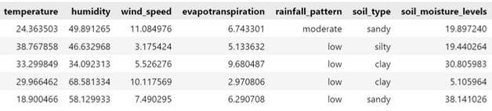

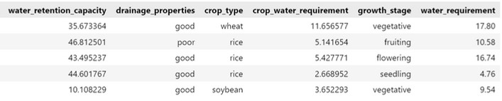
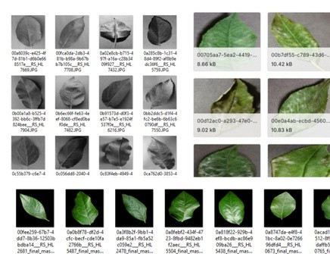


Dataset Description
First Feature: Crop Recommendation System:
N, P, and K represent key soil nutrients vital for plant growth, root development, and disease resistance.
pH affects nutrient availability, while temperature and humidity influence germination and water absorption. Rainfall indicates soil moisture and helps in irrigation planning for optimal crop selection.
Second Feature: Water Requirement Prediction System Temperature, humidity, and wind speed, which directly influence evapotranspiration rates—an important factor in water loss. Evapotranspiration itself measures how much water is transferred from land to atmosphere. Rainfall patterns help determine natural water availability, while soil type, soil moisture levels, and water retention capacity indicate how well the soil holds water. Additional factors like drainage properties, crop type, and growth stage further refine predictions.
87,000 labeled images of plant leaves, covering both healthy and diseased conditions. It includes 38 classes across crops like apple, tomato, grape, and corn, representing various plant diseases and healthy states. The dataset features grayscale, colored, and segmented images,

Slide 5
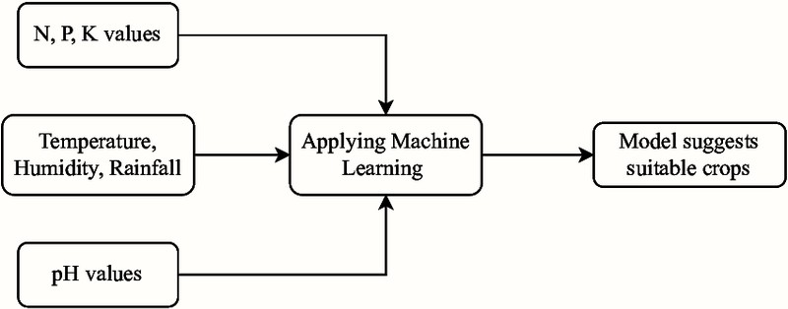

Feature 1: Crop Recommendation System
Input Features: Nitrogen (N), Phosphorus (P), Potassium (K), Temperature (°C), Humidity (%), pH, and Rainfall (mm).
Model: Random Forest algorithm with 100 decision trees.
Process: Accepts user inputs, scales them using StandardScaler, and predicts the most suitable crop.
Benefits: Suggests optimal crops for specific conditions and crop type, reducing input waste and maximizing returns.
Performance: Achieved an accuracy of 95.2% on the test set

Slide 6
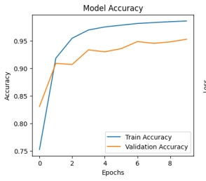

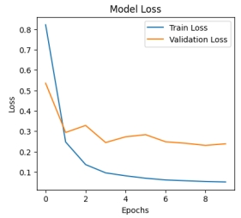


Feature 2: PLant Disease Prediction System
Input: Farmers upload leaf images.
Image Preprocessing: Images resized to 256x256 pixels and normalized.
Model: Convolutional Neural Network developed using TensorFlow's Sequential API. Process: Uploaded leaf images are resized, and passed through the trained CNN model to predict disease or healthy status.
Benefits: Early and accurate disease identification.
Performance: Achieved an accuracy of 85%
Model Training Performance for Plant Disease Detection (CNN) Accuracy and Loss Trends over 10 Epochs

Slide 7

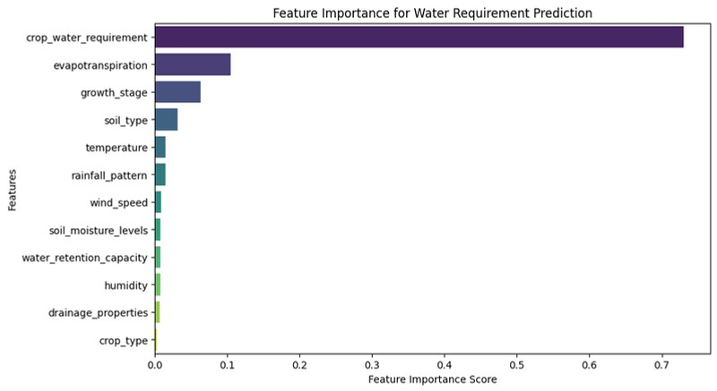
Feature 3: Water Requirement Prediction System
Input Features: Weather, soil, and crop parameters (e.g., Temperature, Rainfall, Soil Type, Growth Stage)
Model: Random Forest Regressor
Process: Predicts daily water need per m², scaled by land area Benefits: Helps farmers optimize irrigation and save water Performance: R² = 0.94, MAE ≈ 0.83; Evapotranspiration was most impactful

Slide 8
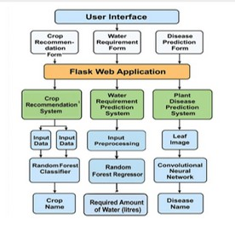
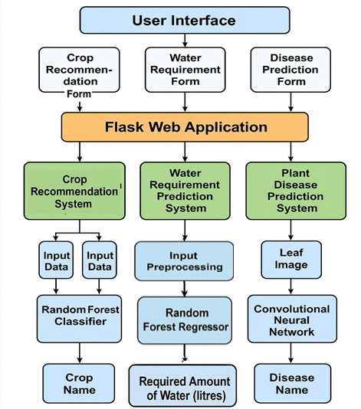
Website WorkfLow

Slide 9
ConcLusion
The project thus combines a user-friendly web platform that leverages Random Forest and CNN models to provide crop recommendations, plant disease detection, and water requirement predictions. It empowers farmers with accurate, data-driven insights, promoting sustainable farming. Future plans include mobile app development, live weather integration, and broader crop disease support.
This project not only enhanced our technical skills but also emphasized the importance of solving real, community-driven problems. This marks a significant step toward smarter, more sustainable farming in today’s digital era.

Slide 10

Thank You

